Slide 1

Hospital Management System Using java Represent by Ajinkya Satkar
Project Co-Ordinator : Junie Denny Solomon

Slide 2
Introduction
Hospital Management System (HMS) is a comprehensive software package that is used to manage all the activities of a hospital. Java is a powerful programming language that is used to develop HMS. It provides a wide range of features that can help hospitals in streamlining their activity.
Java is a robust and secure language that is used by many organizations. It is also an open source language that can be used to create applications for any platform. Java provides an easy to use interface that allows hospitals to manage their data in an efficient manner.

Slide 3
Benefits of Using Java for Hospital Management System
01.

Slide 4
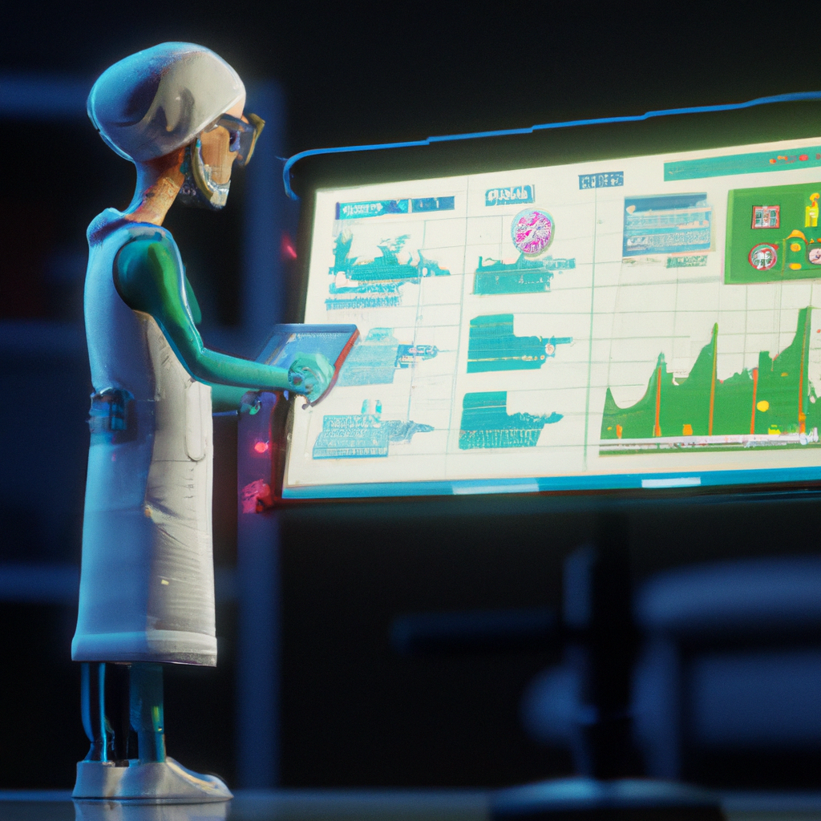
Java is an ideal language for developing HMS due to its scalability, robustness and security. Java is a platform independent language, which means that the same code can be used to run on different platforms. This makes it easier for hospitals to manage their data across multiple systems.
Java is also a powerful language that can be used to develop complex applications. It provides a wide range of features such as database connectivity, web services, and GUI development. This allows hospitals to create custom applications that are tailored to their specific needs.

Slide 5
Features of Hospital Management System Using Java
HMS using Java provides a number of features that can help hospitals in streamlining their operations. It provides features such as patient management, appointment scheduling, and inventory management. Java also provides a secure environment that helps in protecting the confidential data of the hospital.
Java also provides a range of APIs that can be used to develop custom applications. These APIs can be used to create applications that are tailored to the specific needs of the hospital. This helps in providing a better user experience and improving the efficiency of the hospital.

Slide 6

Java Development Tools
Java development tools are essential for developing hospital management systems. These tools include the Java Development Kit (JDK), the Java Runtime Environment (JRE), and the Java Virtual Machine (JVM). These tools provide the necessary environment for developing and running Java applications.
In addition to these tools, there are a variety of frameworks and libraries available for developing Java applications. These frameworks and libraries make it easy to develop complex systems quickly and efficiently.

Slide 7


Java Security
Security is an important factor when developing hospital management systems. Java provides a secure environment for developing and running applications. It has several security features such as authentication, authorization, and encryption.
Java also provides a secure runtime environment for running applications. This ensures that the applications are safe from malicious attacks and data breaches.

Slide 8
Java Database Connectivity
Java provides a wide range of database connectivity options. These options include JDBC, ODBC, and SQLJ. These options make it easy to connect to a variety of databases and access data quickly and efficiently.
Java also provides a wide range of APIs for accessing and manipulating data. These APIs make it easy to develop applications that access and manipulate data quickly and efficiently.
I

Slide 9
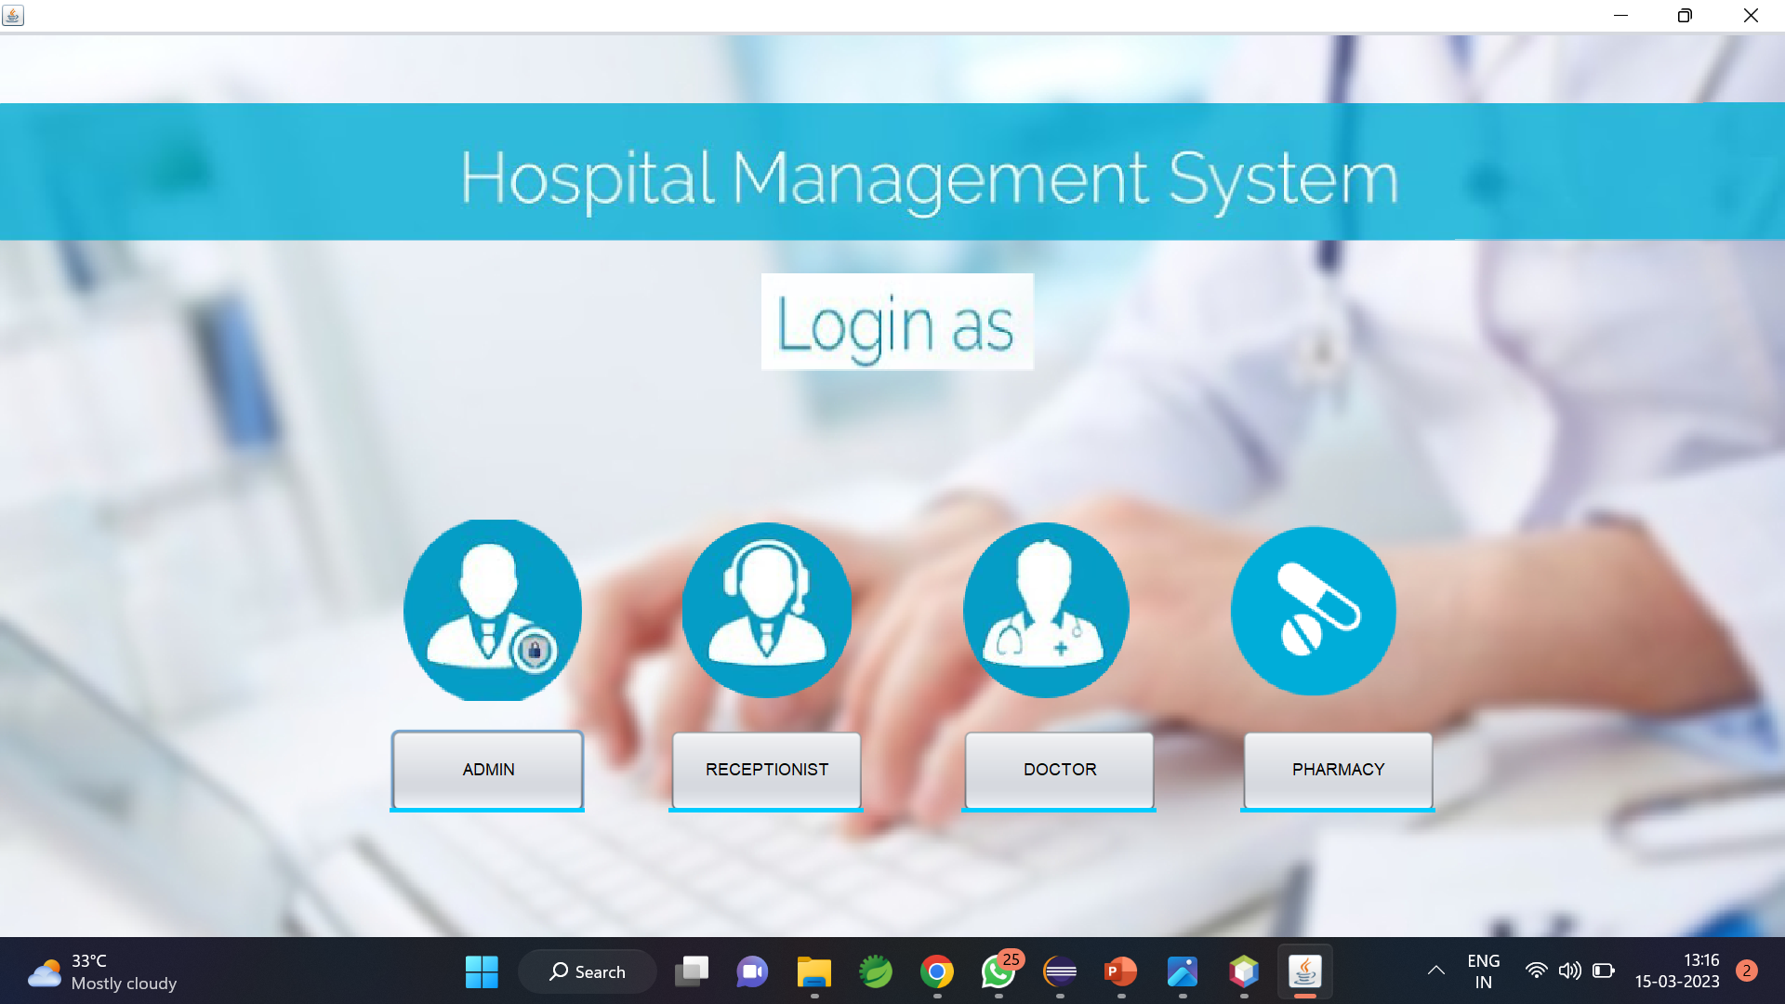
Project Preview
This is the Admin Pharmacy Pannel Input Button
This is the Admin Login Pannel Input Button
This is the Receptionist Login Pannel Input Button
This is the Doctor’s Login Pannel Input Button

Slide 10
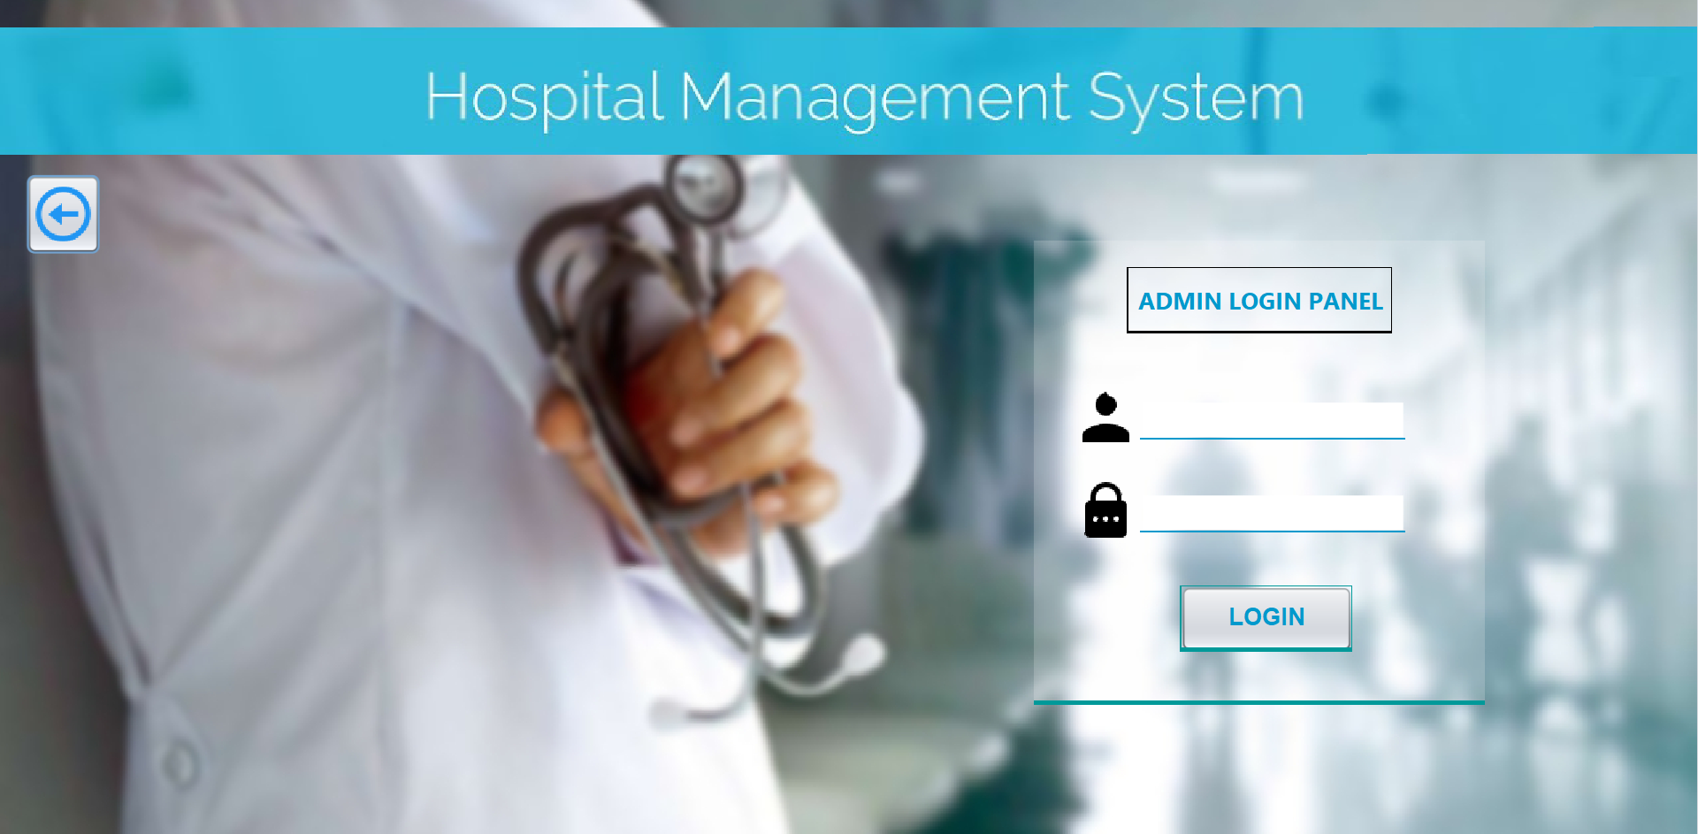
Admin Login Panel

Slide 11
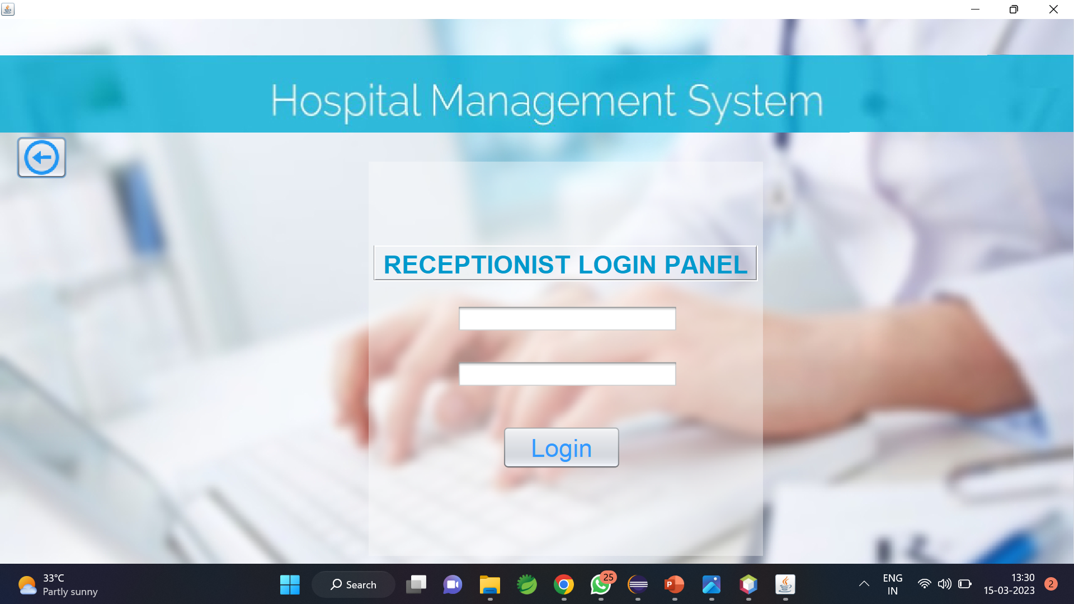
Receptionist Login Panel

Slide 12
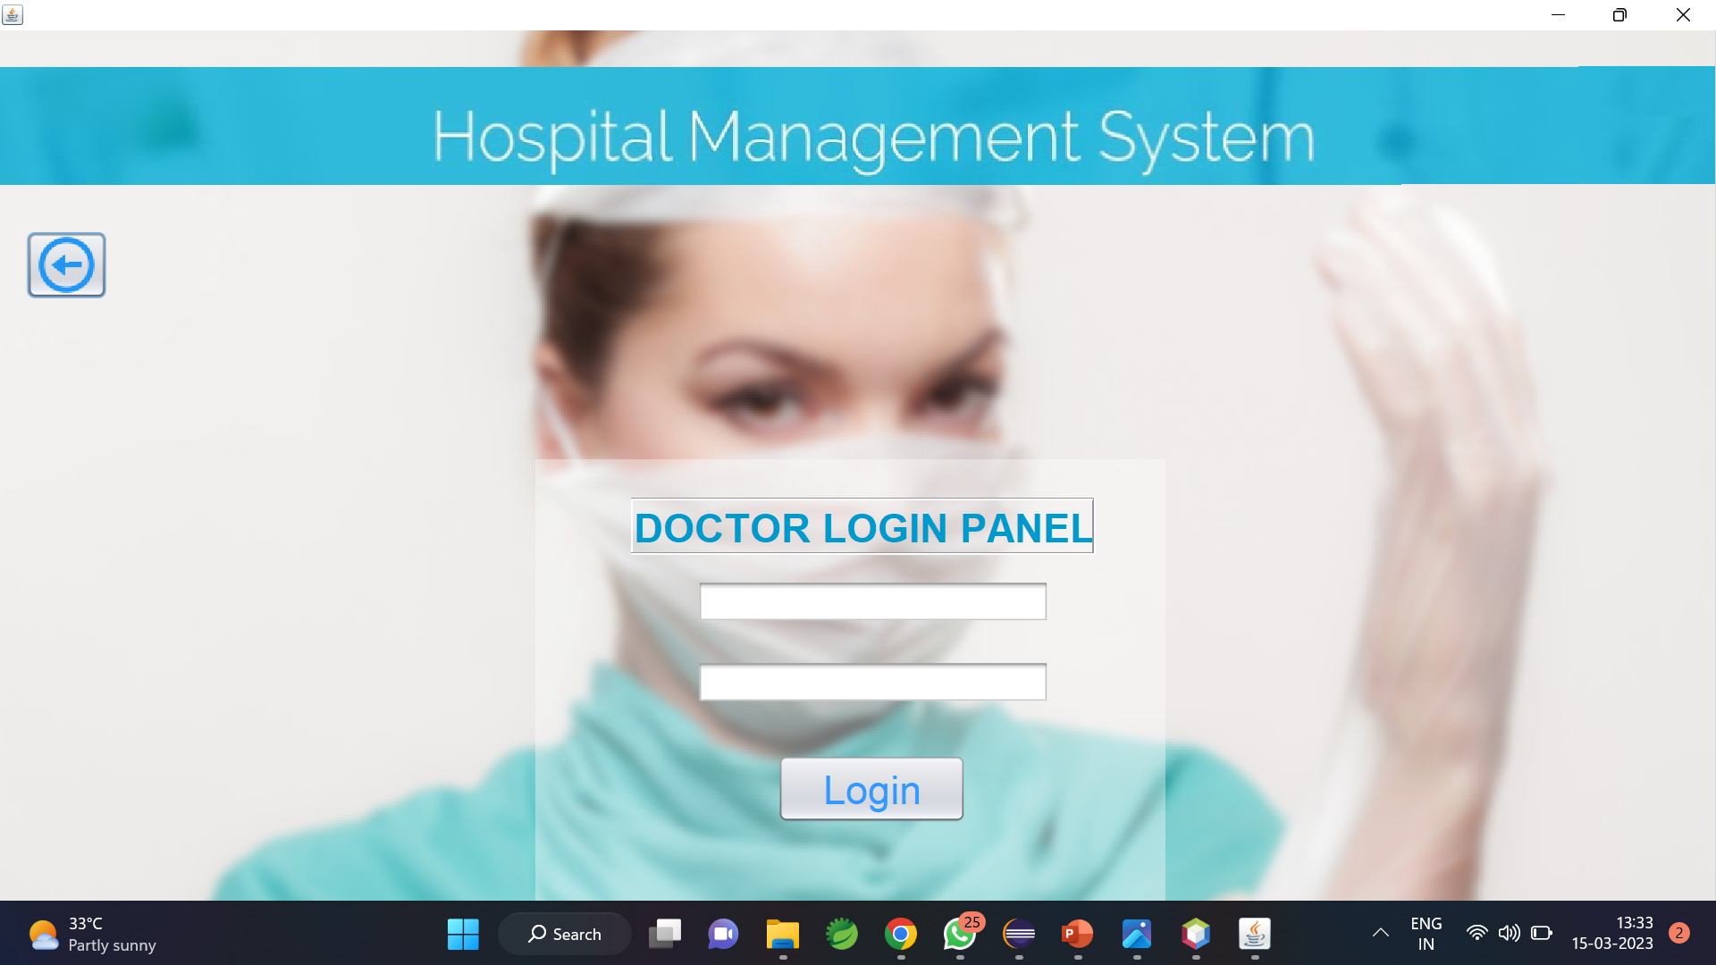
Doctor Login Panel

Slide 13
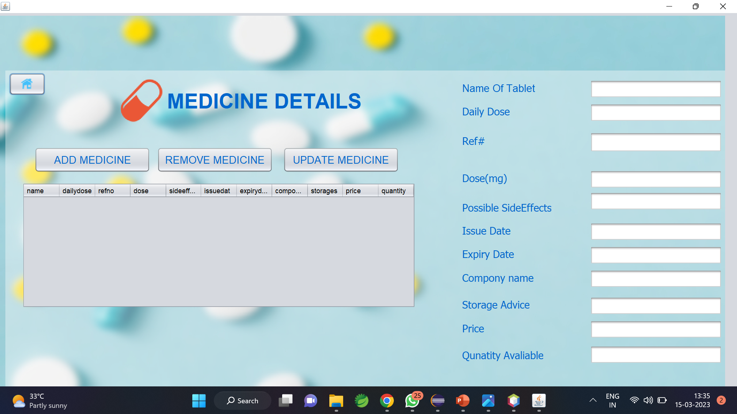
Pharmacy Panel

Slide 14
Features in Admin Panel
Doctor Details
Lowerstaff/Employee Details
Receptionist Details
Patients Details
Bed Avalibility Details
Department Details

Slide 15
Features in Receptionist Panel
Create Appointment
Doctor details
Patient Details

Slide 16
Features in Doctor Panel
Appointments
Patient deatails

Slide 17
Thanks!

